Slide 1


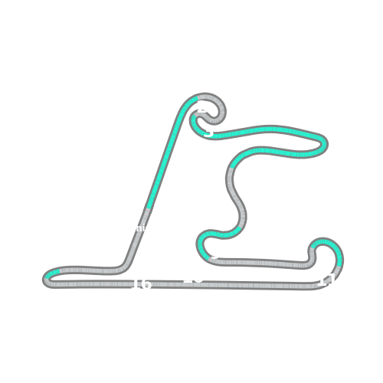


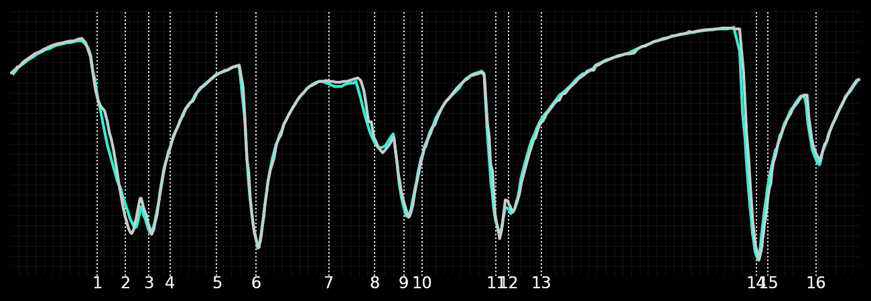
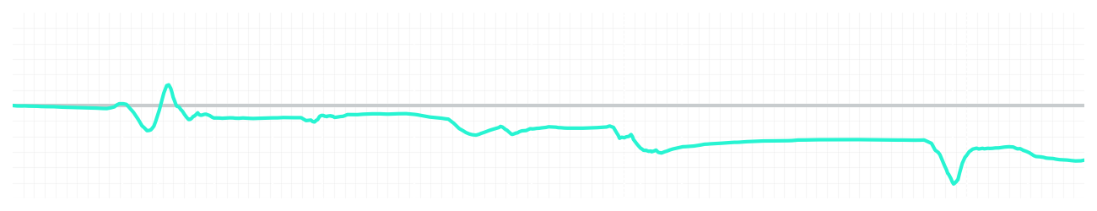
Chinese GP Qualifying Q3
Kimi Antonelli
Driver
George Russell
Driver
Lap Time
01:31.103
01:30.723
Lap Time
Sector 1
24.176
Speed Trap 1
285 kp/h
Speed Trap 1
286 kp/h
Sector 1
24.068
Sector 2
27.301
Speed Trap 2
280 kp/h
Gap
0.38
Gap
-0.38
Speed Trap 2
280 kp/h
Sector 2
27.221
Sector 3
39.626
Speed Final Line
271 kp/h
Corner Advantage
8/17
Corner Advantage
9/17
Speed Final Line
272 kp/h
Sector 3
39.434
FULL THROTTLE
57%
59%
FULL THROTTLE
HEAVY BREAKING
19%
19%
HEAVY BREAKING
%LAP TIME
CORNERING
24%
22%
CORNERING
%LAP TIME
SPEED
SPEED
DELTA TIME
DELTA TIME

Slide 2

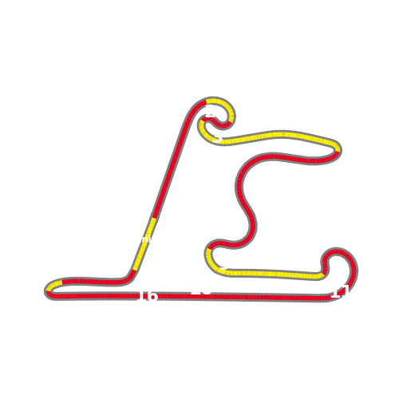


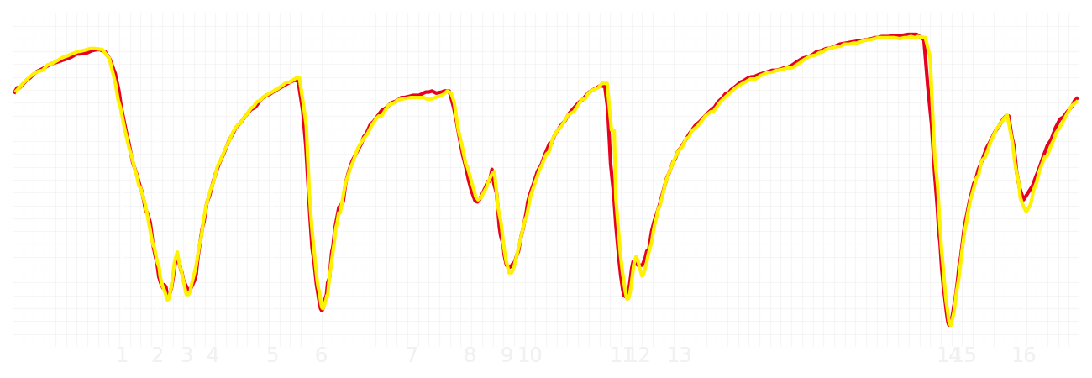
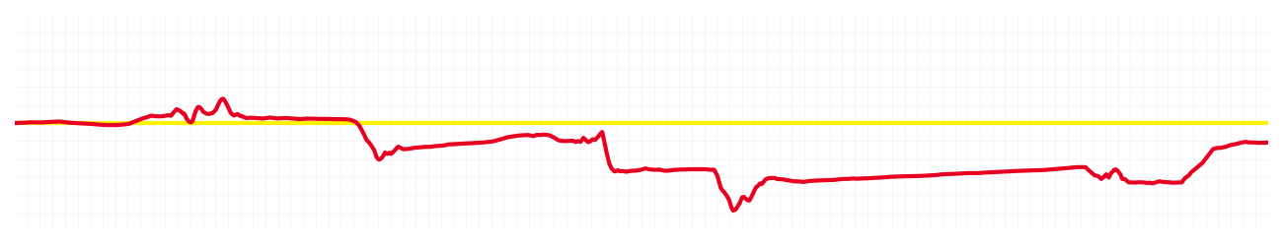
Chinese GP Qualifying Q3
Charles Leclerc
Driver
Lewis Hamilton
Driver
Lap Time
01:31.021
01:30.927
Lap Time
Sector 1
24.094
Speed Trap 1
286 kp/h
Speed Trap 1
287 kp/h
Sector 1
24.148
Sector 2
27.355
Speed Trap 2
281 kp/h
Gap
0.094
Gap
-0.094
Speed Trap 2
281 kp/h
Sector 2
27.175
Sector 3
39.572
Speed Final Line
272 kp/h
Corner Advantage
7/17
Corner Advantage
10/17
Speed Final Line
270 kp/h
Sector 3
39.604
FULL THROTTLE
58%
60%
FULL THROTTLE
HEAVY BREAKING
19%
24%
HEAVY BREAKING
%LAP TIME
CORNERING
23%
16%
CORNERING
%LAP TIME
SPEED
SPEED
DELTA TIME
DELTA TIME

Slide 3

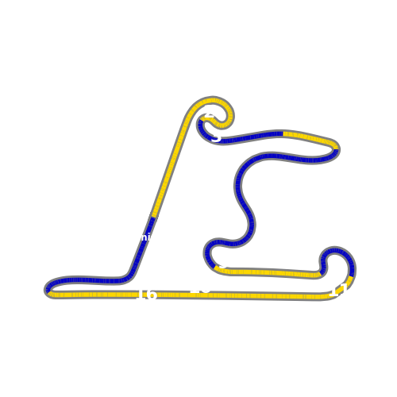


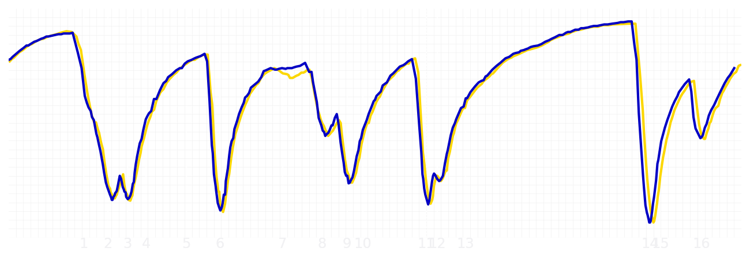
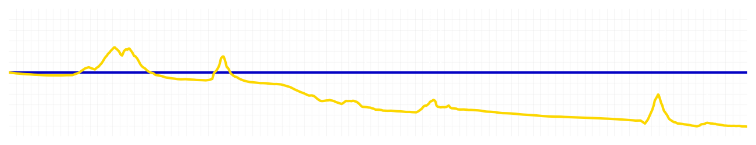
Chinese GP Qualifying Q3
Yuki Tsunoda
Driver
Isack Hadjar
Driver
Lap Time
01:31.638
01:31.079
Lap Time
Sector 1
24.280
Speed Trap 1
285 kp/h
Speed Trap 1
284 kp/h
Sector 1
24.160
Sector 2
27.527
Speed Trap 2
278 kp/h
Gap
0.559
Gap
-0.559
Speed Trap 2
277 kp/h
Sector 2
27.213
Sector 3
39.831
Speed Final Line
272 kp/h
Corner Advantage
11/17
Corner Advantage
6/17
Speed Final Line
270 kp/h
Sector 3
39.706
FULL THROTTLE
56%
60%
FULL THROTTLE
HEAVY BREAKING
15%
18%
HEAVY BREAKING
%LAP TIME
CORNERING
29%
22%
CORNERING
%LAP TIME
SPEED
SPEED
DELTA TIME
DELTA TIME

Slide 4

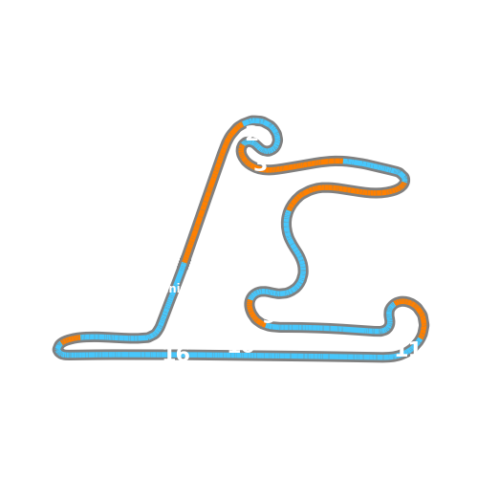


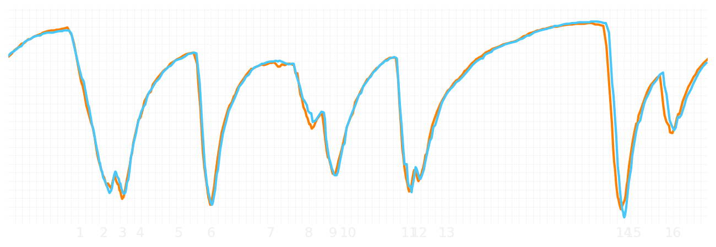
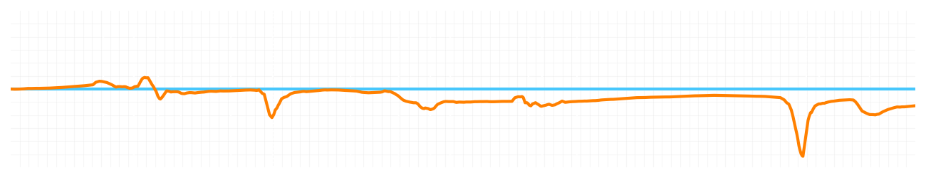
Chinese GP Qualifying Q3
Lando Norris
Driver
Oscar Piastri
Driver
Lap Time
01:30.793
01:30.641
Lap Time
Sector 1
24.030
Speed Trap 1
283 kp/h
Speed Trap 1
284 kp/h
Sector 1
23.996
Sector 2
27.328
Speed Trap 2
278 kp/h
Gap
0.152
Gap
-0.152
Speed Trap 2
278 kp/h
Sector 2
27.227
Sector 3
39.435
Speed Final Line
272 kp/h
Corner Advantage
9/17
Corner Advantage
8/17
Speed Final Line
272 kp/h
Sector 3
39.418
FULL THROTTLE
58%
59%
FULL THROTTLE
HEAVY BREAKING
18%
16%
HEAVY BREAKING
%LAP TIME
CORNERING
24%
25%
CORNERING
%LAP TIME
SPEED
SPEED
DELTA TIME
DELTA TIME

